Slide 1
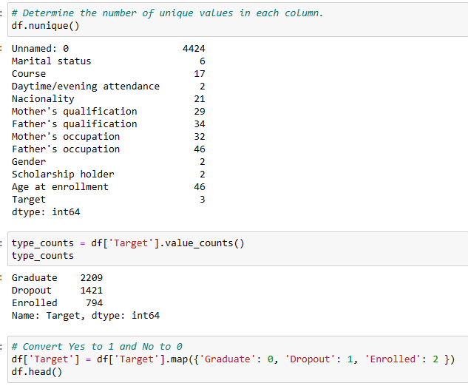
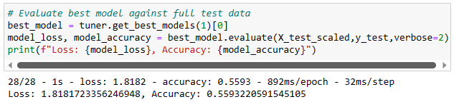
Understanding Initial Machine Learning Failures
Attempt 1: Using an Automated Neural Network Optimizer (Keras-Tuner)
- We started by using an automated neural network optimizer called Keras Tuner.
- The deep neural network (DNN) architecture was chosen, which has multiple layers and nodes.
- The DNN aims to mimic the complexity of the human brain by connecting data points.
- However, without proper exploratory data analysis (EDA), we relied solely on our instincts to determine the most important features.
- The accuracy score obtained from this attempt was 0.559, which is quite low.

Slide 2
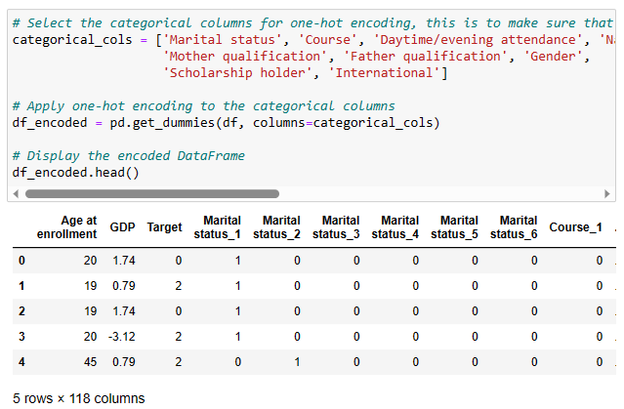
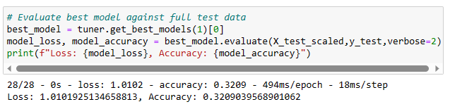
Understanding Initial Machine Learning Failures
Attempt 2: One-Hot Encoding the Dataset
- In the second attempt, we decided to one-hot encode our dataset.
- One-hot encoding converts categorical data into binary values, allowing the algorithm to treat them as categories rather than numerical values.
- However, this approach can lead to problems when the number of categories becomes too high.
- In our case, we ended up with 117 columns after one-hot encoding, which introduced a lot of noise.
- The resulting accuracy score was even lower, at 0.32, indicating an underfitting model.

Slide 3

Understanding Initial Machine Learning Failures
Troubleshooting
To address the issues faced in our initial attempts, we need to troubleshoot the problems.
Our dataset we had 117 columns which was too much, and this could have created a lot of noise causing the model to underfit.
High bias in the model can be caused by outliers or skewed data points that deviate significantly from most of the dataset.
We need to examine the data more closely and preprocess it appropriately.
Feature selection techniques such as correlation analysis, feature importance, or domain knowledge can help identify the most relevant features.
It is essential to strike a balance between model complexity and the amount of available data to prevent overfitting or underfitting.
Notes:
- Machine learning failures are a part of the learning process.
- By analysing and understanding the reasons behind these failures, we can improve our models.
- Troubleshooting involves careful data exploration, feature selection, and preprocessing.
- It is crucial to strike the right balance between model complexity and available data.
- With each iteration, we learn and refine our machine learning models.

Slide 4
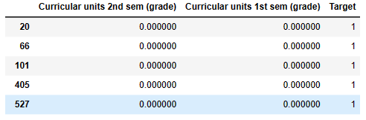
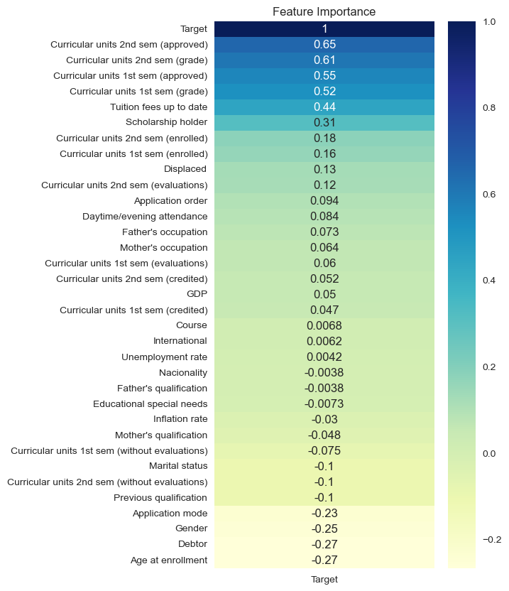
Enhancing Model Performance with PyCaret
1. Exploratory Data Analysis (EDA)
Investigated and evaluated the raw data for dropout and graduation prediction
Dropped the 'enrolled' column as it wasn't the target variable of interest
Checked for missing values, distribution of the target variable, and overall data quality
Focused on the columns 'semester grade 1', 'semester grade 2', and the target variable
Identified grades below 10 as potential failures and reasons for dropout
Removed the column with illogical data (graduation with zero grades)
Created a correlation map to identify columns with low correlation to the target variable
Dropped columns with no significant correlation to the target variable

Slide 5
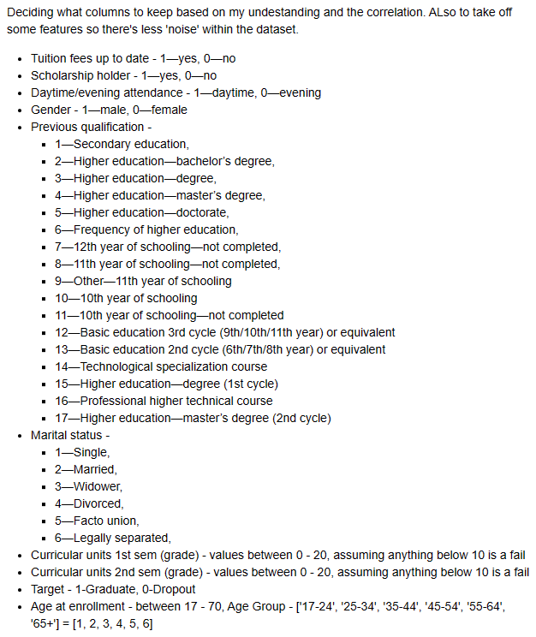

Slide 6
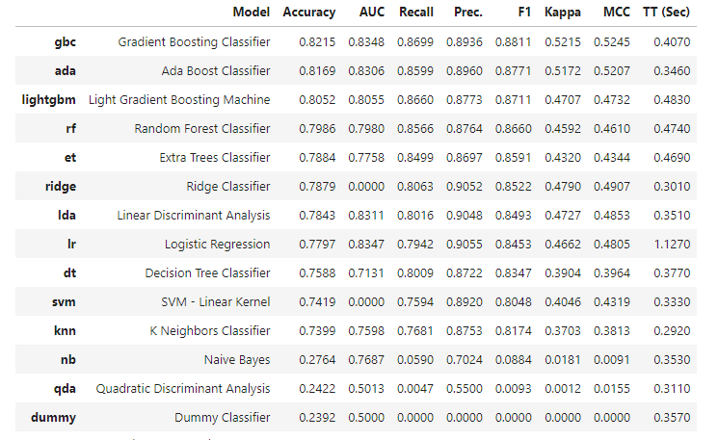
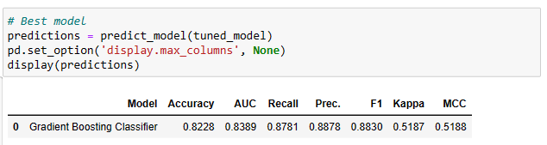
Enhancing Model Performance with PyCaret
2. PyCaret for Machine Learning
Utilized PyCaret, an open-source, low-code machine learning library, for automated workflow
Enhanced model performance: Utilizes a wide range of algorithms and techniques
PyCaret simplifies tasks such as data preparation, train-test split, and transformations
Generated a table with the best performing models, with the highest accuracy score at 0.82
Gradient Boosting Classifier was selected as the best model by PyCaret
Tuned the model and achieved a slight improvement to an accuracy score of 0.8228
Explored the evaluate function in PyCaret, providing various visualizations such as confusion matrix, learning curves, and feature importance
Notes:
Model: Refers to the name of the model used, in this case, the Gradient Boosting Classifier.
Accuracy: Represents the proportion of correctly classified instances out of the total instances in the dataset. It indicates how well the model predicts the correct class labels overall.
AUC (Area Under the Curve): Measures the performance of the model by calculating the area under the Receiver Operating Characteristic (ROC) curve. It assesses the model's ability to distinguish between positive and negative classes.
Recall: Also known as sensitivity or true positive rate, it measures the proportion of actual positive instances correctly identified by the model. It indicates how well the model captures the positive instances.
Precision: Represents the proportion of correctly predicted positive instances out of all instances predicted as positive by the model. It assesses the correctness of positive predictions made by the model.
F1: Harmonic mean of precision and recall. It provides a balance between precision and recall, considering both false positives and false negatives. Higher values indicate a better trade-off between precision and recall.
Kappa: Measures the agreement between the model's predictions and the actual labels, taking into account the possibility of correct predictions occurring by chance alone. It considers the imbalance in class distribution.
MCC (Matthews Correlation Coefficient): Evaluates the quality of binary classification models, taking into account true positives, true negatives, false positives, and false negatives. It considers both class imbalance and binary confusion matrices.
Gradient Boosting Classifier:
Gradient Boosting is an ensemble learning technique that combines multiple weak prediction models (typically decision trees) to create a strong predictive model.
It builds an ensemble of models sequentially, where each subsequent model focuses on correcting the mistakes made by the previous models.
Gradient Boosting Classifier is specifically designed for classification tasks, making it suitable for predicting categorical outcomes.
Advantage of using Gradient Boosting Classifier:
High predictive accuracy: Gradient Boosting often achieves high accuracy due to its ensemble approach and ability to capture complex relationships in the data.
Handling heterogeneous features: It can handle a combination of numerical and categorical features effectively.
Robustness to outliers: Gradient Boosting can handle outliers and noisy data by assigning lower weights to misclassified instances during training.
Feature importance: It provides a measure of feature importance, allowing for insights into which features contribute most to the model's predictions.
The Gradient Boosting Classifier, based on your results, achieved an accuracy of 0.8228 and showed good performance in terms of recall, precision, F1 score, Kappa, and MCC.

Slide 7
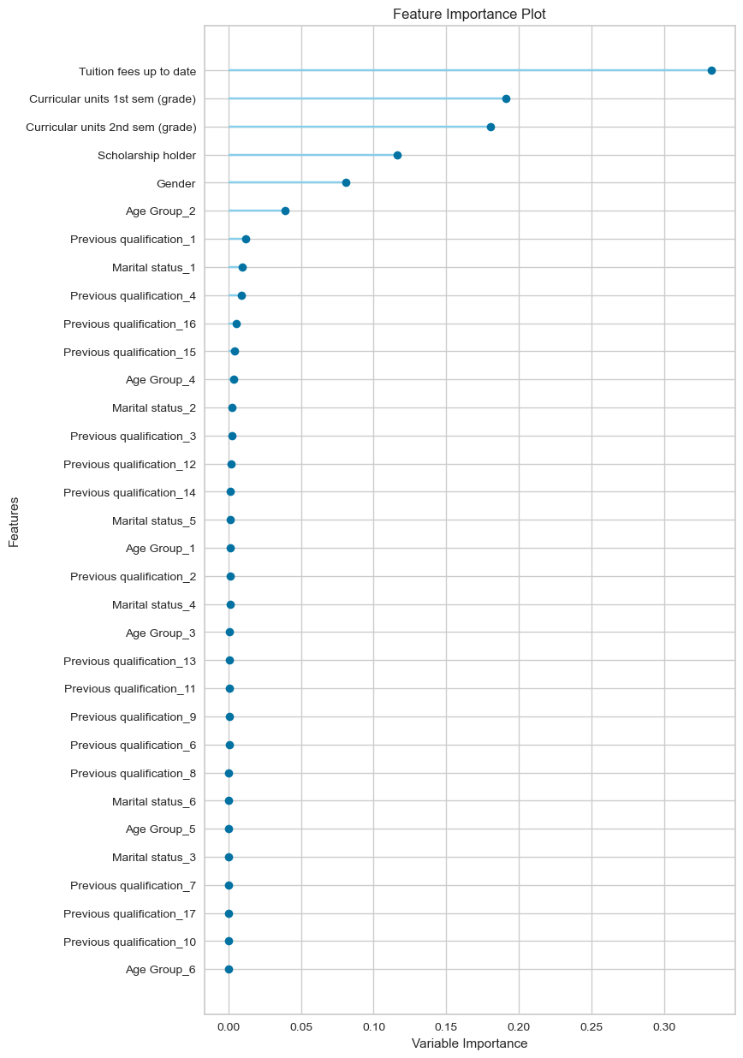
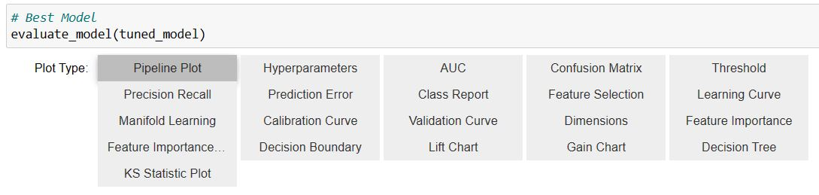
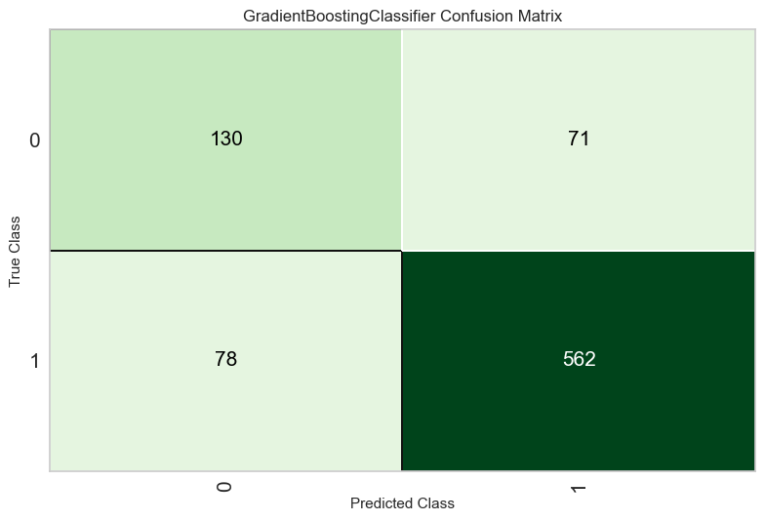
Enhancing Model Performance with PyCaret
Notes:
True Positive (TP):130 (15.45%) instances where the model correctly predicted Class 0.
False Negative (FN): 71 (8.45%) instances where the model incorrectly predicted Class 1 instead of Class 0.
False Positive (FP): 78 (9.27%) instances where the model incorrectly predicted Class 0 instead of Class 1. we want to avoid, test say you will graduate but you actually don’t.
True Negative (TN): 562 (66.83%) instances where the model correctly predicted Class 1.

Slide 8
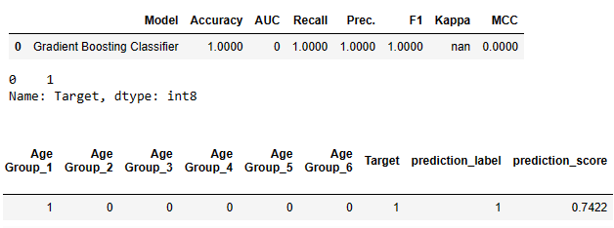
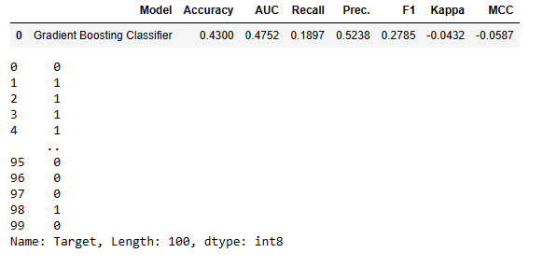
Enhancing Model Performance with PyCaret
Trained the model using a test dataset with logical input, which produced accurate predictions
Tested the model with randomly generated data using the random function, resulting in a lower accuracy score of 0.43
Potential reasons for lower performance with random data:
Lack of meaningful patterns: Random data may lack the patterns and relationships found in real data
3. Model Training and Testing

Slide 9
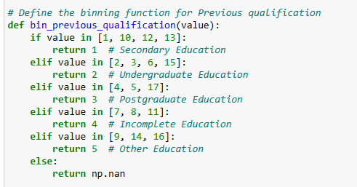


Enhancing Model Performance with PyCaret
4. Model Optimization Attempts
Optimized the model by binning the 'previous qualification' column from 17 one-hot encoded columns to five bins
Re-evaluated the model, but it performed slightly worse with an accuracy score of 0.819
Attempted another optimization by dropping the least important column based on feature importance plot (e.g., marital status and previous qualification)
Despite the optimization attempts, the model still performed slightly worse overall, with an accuracy score of 0.807

Slide 10
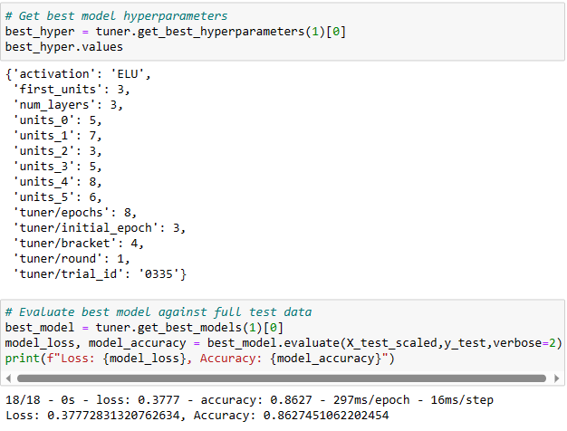
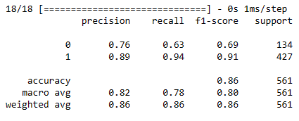

Leveraging Deep Learning for Improved Predictive Accuracy
1. Revisiting Deep Learning
Returned to deep learning for improved predictive accuracy
Used the same dataset as in the previous PyCaret analysis
Employed Keras Tuner, an advanced neural network optimizer
Utilized Keras Tuner to optimize the neural network model
Achieved a significant improvement in accuracy with a score of 0.86
Significantly outperformed the previous PyCaret-based model
Evaluated the model's performance with a test dataset created using logical reasoning
The model accurately predicted the positive class with a probability of approximately 0.979
Confidence in the model's ability to make accurate predictions based on new data inputs
Notes:
Precision focuses on the accuracy of positive predictions. Eg, how many 1s are actually 1.
For recal we are only looking at FN (you do have it but algorithm says you don’t) and TP (test says you will graduate(1)/or dropout(0)) a recall of 0.63 for Class 0 means that the model correctly identified 63% of the actual instances that belonged to Class 0.
The remaining 37% would be the false negatives, which means that the algorithm incorrectly predicted those instances as Class 1 when, in reality, they belonged to Class 0. This indicates instances that were misclassified by the model and were false negatives with respect to Class 0.
Recall is a measure of the model's ability to capture all positive instances correctly. A lower recall value suggests that the model may have missed a significant portion of the instances that actually belonged to Class 0, leading to false negatives in the predictions.

Slide 11
Model Limitations
No model is perfect; understanding limitations helps manage expectations
Limitations to consider in your project:
The provided data booklet or dictionary did not offer comprehensive information about the dataset, leading to difficulties in understanding the context and interpreting certain columns.
Lack of clarity regarding the meaning and interpretation of specific columns, such as "curricular unit 2nd sem (approved)" which had values ranging from 0 to 20.
The limited information hindered the ability to fully leverage potentially valuable features, resulting in potential missed opportunities for model improvement.
Computational resources: Deep learning models require significant computational power
Could not test our model with real data to see how well it would perform.
-

